Slide 1
Deep Cars
( Simulation of self-driving car using Deep Neural Network )
Computer & Information Systems Engineering
Mid Year Evaluation Presentation
Final Year Design Project 2023
Internal Advisor: Syed Abbas Ali
FYDP Examiner: Dr.-Ing. Shehzad Hasan

Slide 2
The TEAM behind DeepCars
CS-19149
Muhammad Hammad
CS-19302
Muhammad Jan
CS-19303
CGPA: 3.402
Musfirah Fayyaz
CS-19304
CGPA: 3.679
Faseeh U Rehman
CGPA: 3.15
CGPA: 3.49
“Teaching Cars To Think For Themselves!”

Slide 3
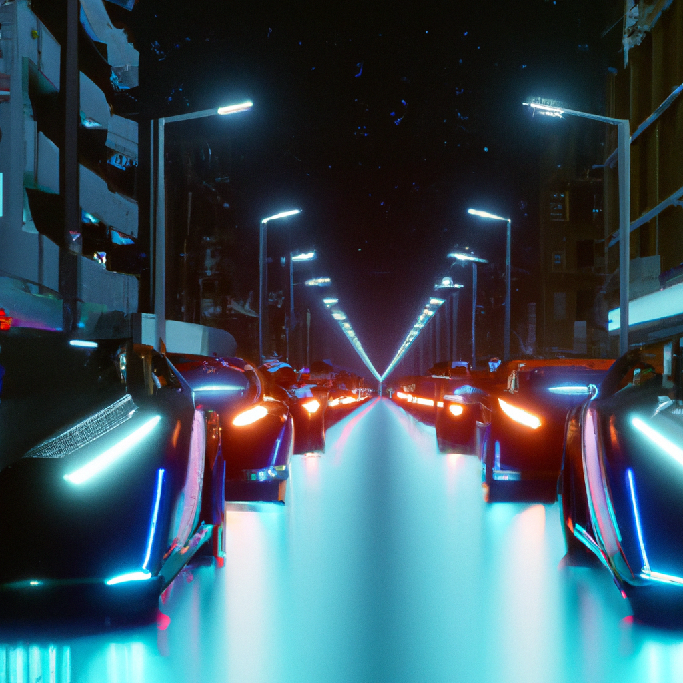
BACKGROUND
People in this contemporary era try to save time.
Traditional manual driving is associated with Human Errors, such as Impaired Driving, is a major cause of road accidents.
These cars rely on Fossil Fuels, contribute to Environmental Pollution & Climate Change.
So, Self-Driving Cars are a boon for humans in terms of Safety, Environment Concerns and Time Saving.
“Safer Roads, Smarter Cars!”

Slide 4
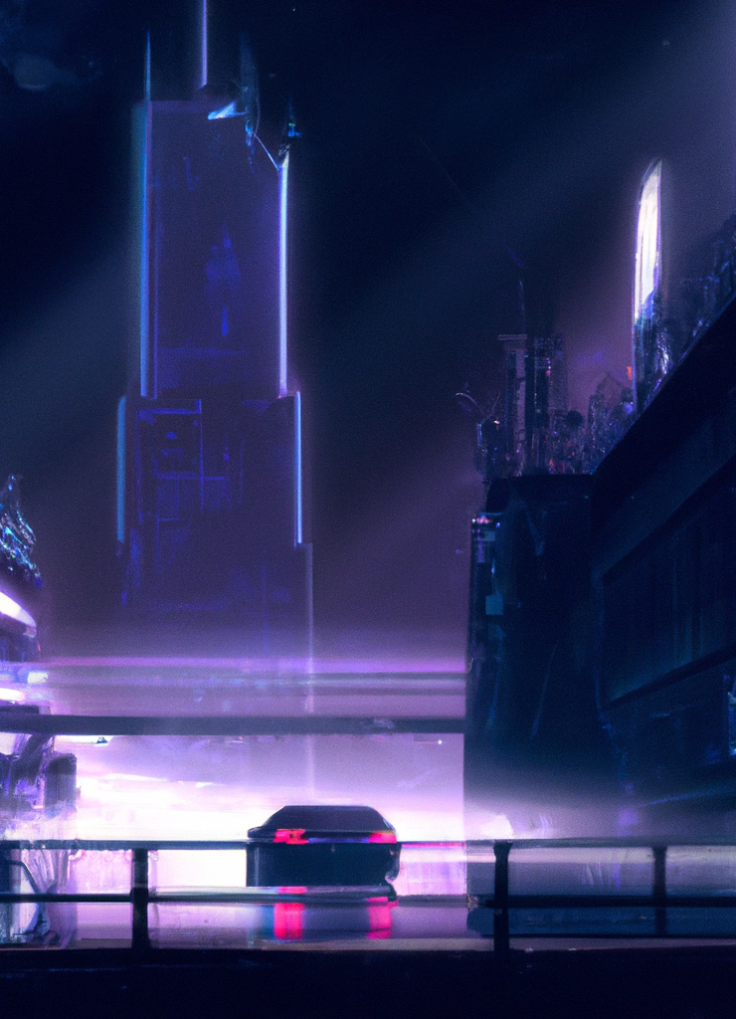
“Driving Innovation with Deep Learning!”
INTRODUCTION
Self-driving cars are seen as a solution to problems associated with traditional manual driving.
10x safer than Human driven cars.
Have the potential to reduce accidents, improve traffic flow, and reduce carbon emissions.
Reduce cancer as they decrease anxiety & driving stress.
Understand and process the surrounding environment.

Slide 5
TASK DIVISION
Muhammad Jan
Faseeh U Rehman
Modeled the
Agent (Car).
Designed & developed Realistic cars Traffic.
Generated random colored cars.
Practicing to implement CNN, RL & RTC
Implemented prototype of the Environment
Implemented different natural aspects of the Agent.
Implement Sensors
Practicing to implement CNN, RL & RTC
1.
2.
Musfirah Fayyaz
3.
Muhammad Hammad
Traffic simulation of multiple cars.
Developed traffic randomly coming from any lane.
Worked on car drawing.
Practicing to implement CNN, RL & RTC
4.
Practicing to implement Convolutional Neural Network, Reinforcement Learning & Real Time Communication
However, every team member has jointly planned & discussed everything and was present in every scheduled project meeting.

Slide 6
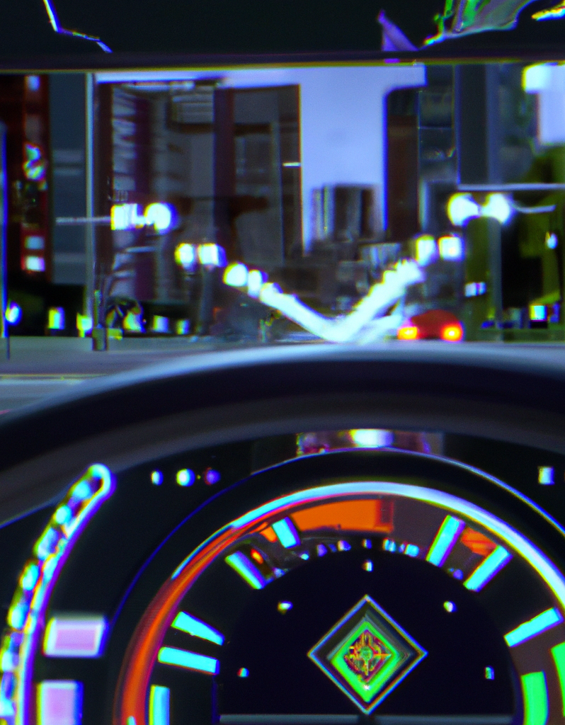
MOTIVATION
Transportation will no longer be a Hindrance for
The disabled
The elderly
Even the kids
Beneficial for;
Those who can’t drive:
under age
have no driving license
those who can’t go themselves
health Issue
who prefer not to drive
too busy or lazy to drive the car

Slide 7
Flow of the Project
Design & Train Deep Neural Network
Report
Analysis & Documentation
Environment Design & Development
Agent Development
Testing & Quality Assurance
“Unleashing the power of machine learning on the roads!”

Slide 8
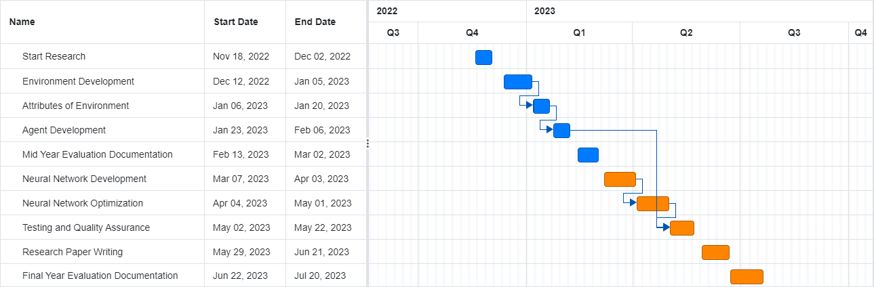
GANTT CHART

Slide 9
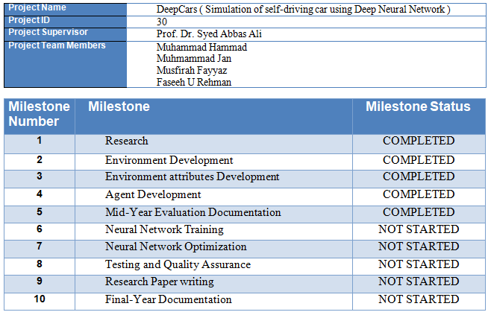
Milestone Achieved Summary Checklist

Slide 10
PROS & CONS
CONS
PROS
Timely Updation Required
Steer itself
Object Detection Problem
Echo Friendly
Human intervention needed in shifting from slow lane
Saves Time
Expensive Technology
Improve Mobility
“Revolutionizing the way we move!”

Slide 11
CHARACTERISTICS OF AN AGENT
Agent will try to avoid the collision using sensor data.
Agent’s Possible Actions
01 | Forward
02 | Backward
03 | Turn Left
04 | Turn Right
05 | Brake
06 | Do Nothing

Slide 12
ENVIRONMENT CHARACTERISTICS
01
7 Lanes One Way Expressway
02
Traffic Vehicles

Slide 13
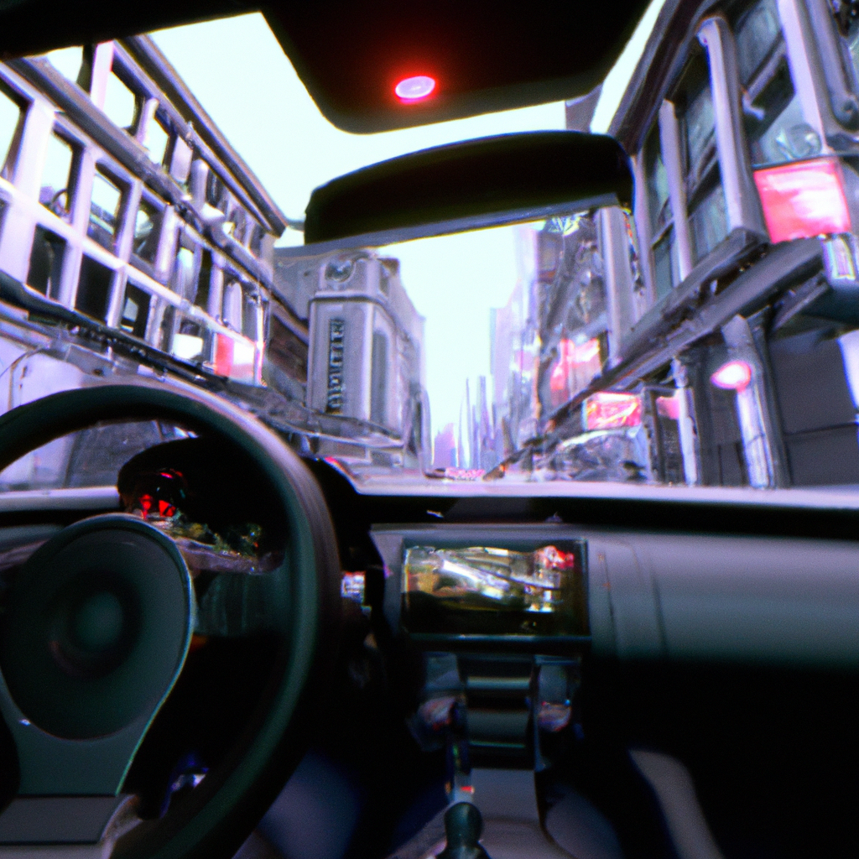
Future Enhancement
Neural Network will be implemented for our Agent.
Car’s speedometer.
Two-way express way might be implemented later.
Different types of vehicles like fast-moving, slow-moving, big, small etc may be added.
"Where technology meets the Highway!”

Slide 14
“Driving Innovation with Deep Learning!”
Reinforcement Learning
IMPLEMENTATION
We have decided to train a Convolutional Neural Network using Reinforcement Learning.
ALGORITHM
Q-Learning will be used to train CNN.
Implement double Q-learning to train the CNN.

Slide 15

REWARDING SCHEME
Through which agent will get to know about value of actions.
No of cars overtake = 10
No of seconds Agent survived*1
Lane Shift = 50

Slide 16
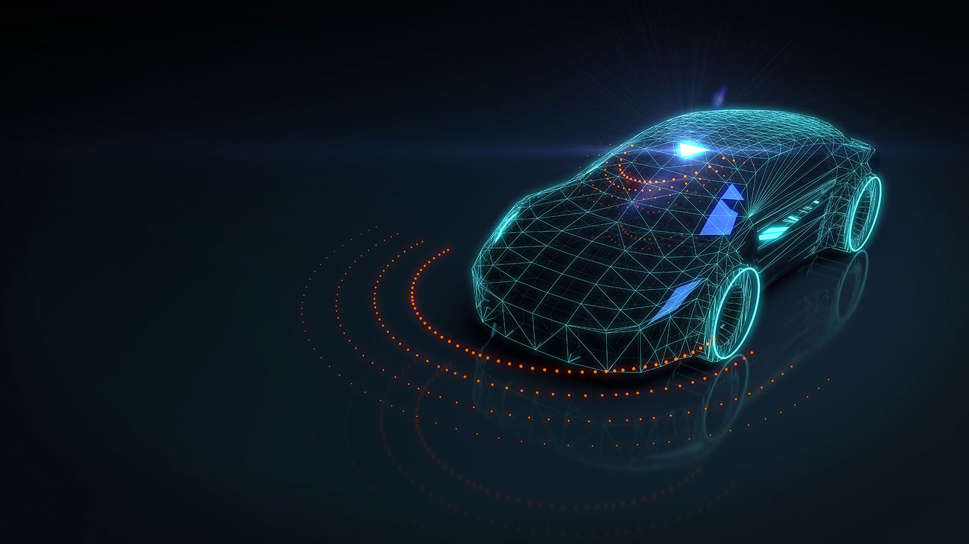
CONCLUSION
The idea of self-driving cars has been around for decades, but recent advancements in technology have brought this idea closer to reality than ever before.
This technology in general is becoming increasingly common and could revolutionize our transportation system.
It has the potential to greatly benefit society.
"The future of driving is autonomous!"

Slide 17
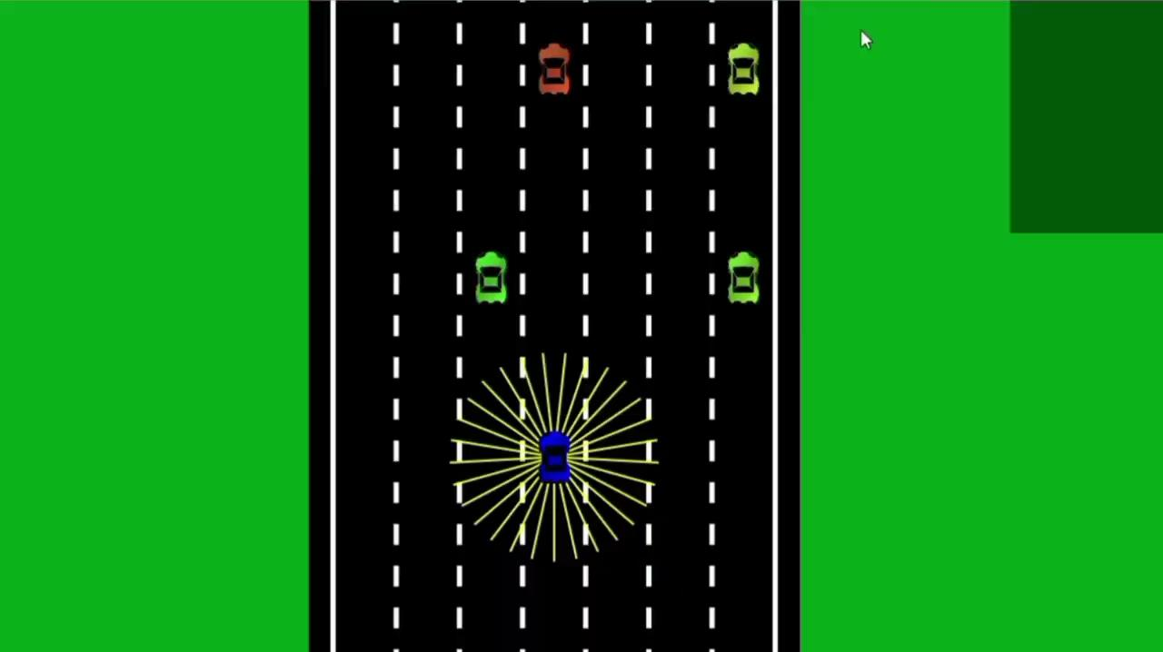
VIDEO DEMONSTRATION

Slide 18
THANK YOU FOR BEARING WITH US!
"Training the future of transportation!"

